Slide 1

HEALTH EFFECTS OF NUCLEAR POWER INCIDENTS – WHERE CHEMISTRY AND PHYSICS COMBINE TO DRIVE BIOLOGY
Professor Gerry Thomas
Professor of Molecular Pathology ICL
Director, Chernobyl Tissue Bank (www.chernobyltissuebank.com)
gerry.thomas@imperial.ac.uk

Slide 2
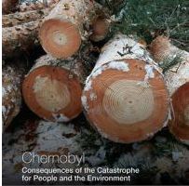

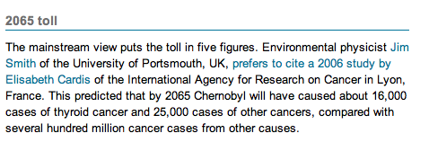
Public Perception of Radiation
http://www.globalresearch.ca/new-book-concludes-chernobyl-death-toll-985-000-mostly-from-cancer/20908
http://www.newscientist.com/article/dn20403-25-years-after-chernobyl-we-dont-know-how-many-died.html

Slide 3
Public Perception of Radiation
Chernobyl accident happened in 1986. In you opinion, how many people died because of the Chernobyl radiation exposure?
Fukushima accident happened in Japan in 2011. In you opinion, how many people died because of the Fukushima radiation exposure?
All Russia omnibus 24.10.2012

Slide 4
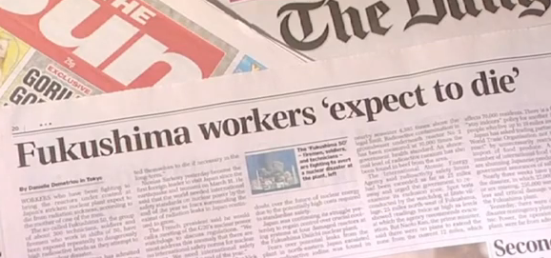
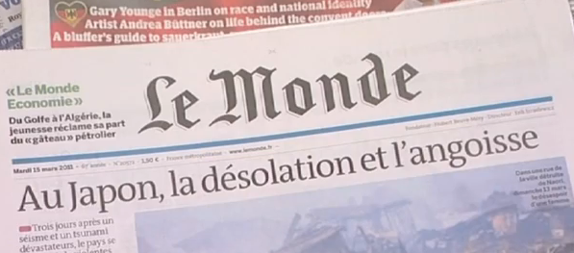
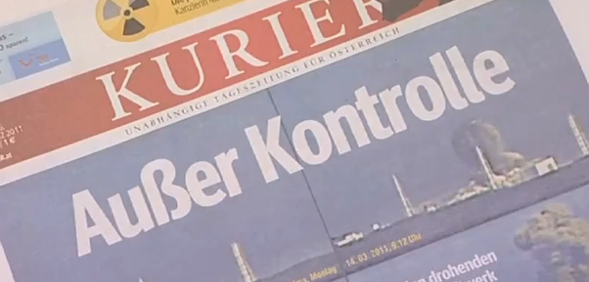
Sensationalist reporting

Slide 5
Separating Fact from Fiction
We live in a naturally radioactive world, and as a species have developed biological mechanisms to protect us
More exposure from natural radiation than man-made sources
Annual dose varies around the world, and within a single country

Slide 6
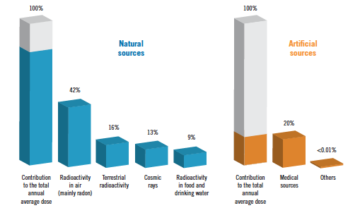
Sources of radiation
http://whqlibdoc.who.int/publications/2012/9789241503662_eng.pdf

Slide 7
Relative radiation doses
Source of Exposure | Dose
Dental X-ray | 0.005mSv
135g of Brazil Nuts | 0.005mSv
Chest X-ray | 0.02mSv
Transatlantic flight | 0.07mSv
Nuclear Power station worker, average annual dose | 0.18mSv
UK average annual radon dose | 1.3mSv
CT scan of the head | 1.4mSv
UK average annual dose | 2.7 mSv
CT scan of the chest | 6.6 mSv
Whole body CT scan | 10 mSv
Annual limit for nuclear radiation workers | 20mSv
Level at which increased cancer incidence seen | 100mSv
LD50 (within a month of exposure) | 5000mSv
http://www.hpa.org.uk/Topics/Radiation/UnderstandingRadiation/UnderstandingRadiationTopics/DoseComparisonsForIonisingRadiation/

Slide 8
Radiation facts
For radiation to cause damage to cells, it must come into contact with them.
Mechanism of contact depends on type of radiation – wave (γ, X-ray) or particulate (α, β).
Radiation exposure can be external (γ) or internal (α, β)

Slide 9
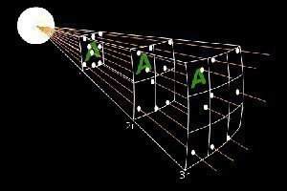
Radiation facts
Dose of radiation falls rapidly with distance from source (inverse square law)
Environmental and health consequences of a nuclear accident depend on physics, chemistry and biology

Slide 10

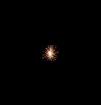
Radiation Physics
Physical half-life governs the time period of release of radiation
  Short physical half-life means that radiation is released quickly i.e. it has a high dose rate
  Long physical half life means that radiation is released over a long period of time i.e. it has a lower dose rate

Slide 11
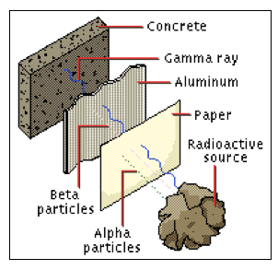
Radiation Physics - Biology
Different types of radiation have different energies – affects how far they can penetrate
To damage cellular structures inside the body, isotopes that emit alpha and beta radiation need to be inhaled or ingested

Slide 12
Radiation Chemistry
Biological structures exist in a constant state of flux – chemicals pass in and out of the structure
Chemistry of the soil determines how the radioactive isotopes behave in the environment
The interaction between chemistry and biology determines how long a radioactive isotope stays within a tissue

Slide 13
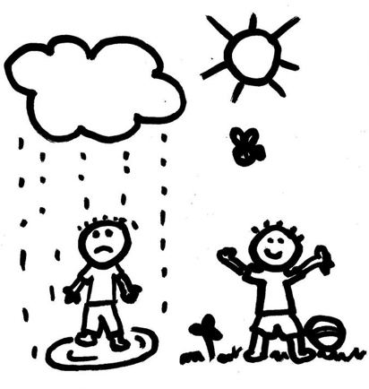
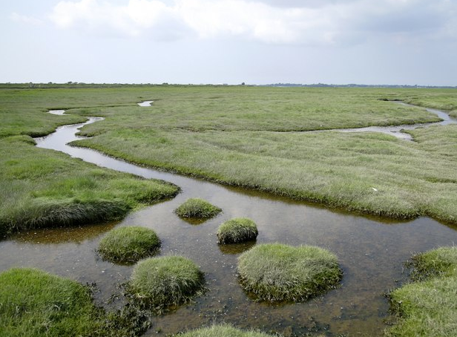

Radiation Chemistry - Ecology
Environmental behaviour depends on
  physical and chemical nature of element
  type of fallout (dry or wet)
  characteristics of environment

Slide 14
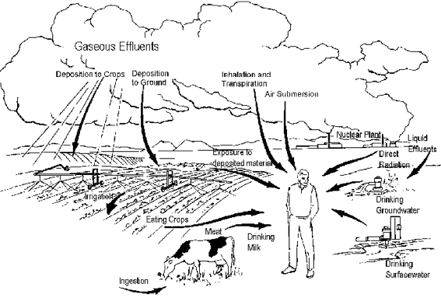
Routes for human exposure
Inhalation of volatile isotopes e.g. 131-I, 137-Cs
Ingestion of contaminated food
Gamma radiation from groundshine

Slide 15
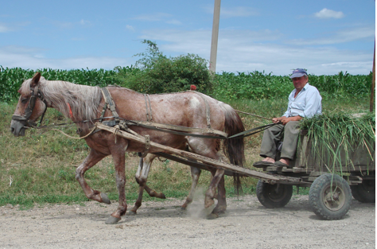

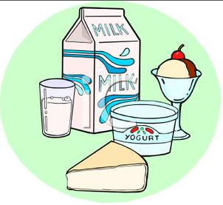

Radiation doses received influenced by
  route of exposure (inhalation, ingestion etc)
  type of economy (rural different from city)
  Eating habits of population

Slide 16
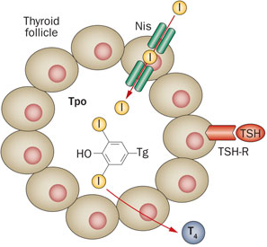

Radiation Chemistry - Biology
Active pump mechanism
Binds to large protein within follicular lumen

Slide 17
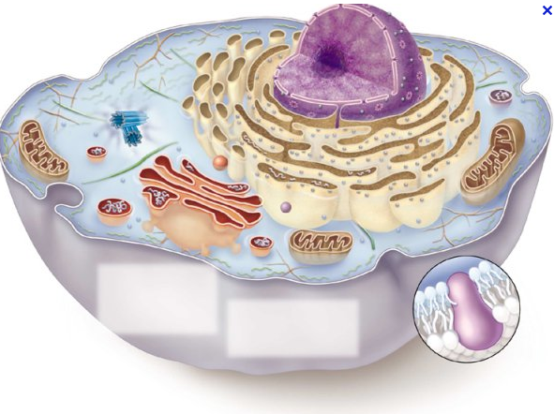
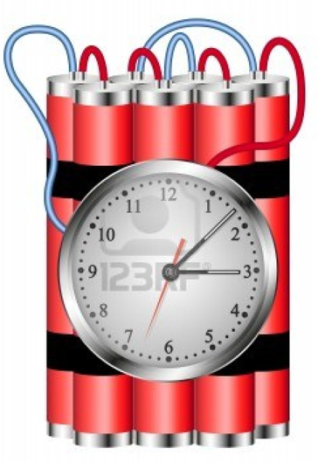
Biological effect of radiation depends on the amount of time the radioactive isotope stays in the body (biological half-life) and the frequency with which the isotope emits radiation (physical half-life)
Long physical half-life, short biological half-life – little effect
Short physical half-life, long biological half-life – big problem

Slide 18
Health effects of radiation exposure
Atomic bomb (Hiroshima and Nagasaki)
  large population exposed to high dose radiation close to explosion site
  low doses to population further away
  mainly gamma, but some α and β
Chernobyl accident
  Large dose to small numbers of people
  Low dose to majority of population
  Mainly β from isotopes of iodine and caesium

Slide 19
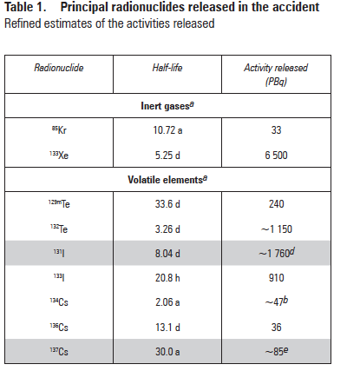
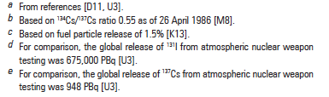
What was released?
NB: Release of Cs from Fukushima about 1/5th of release from Chernobyl. Overall release about 10%
www.unscear.org/docs/reports/2008/11-80076_Report_2008_Annex_D.pdf

Slide 20
Methods to limit exposure
Move population away from source
Limit inhalation by staying inside and keeping windows and doors shut
Stop ingestion of contaminated foodstuffs
Block uptake of radionuclides (e.g. stable iodine prophylaxis)

Slide 21
Effects on human health
Two types of health effects of radiation:
Deterministic – effect is certain under specific conditions e.g. high dose/ARS
Stochastic – may or may not occur. Difficult to predict on an individual level but effects seen at a population level e.g. cancer after radiation exposure

Slide 22
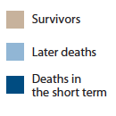
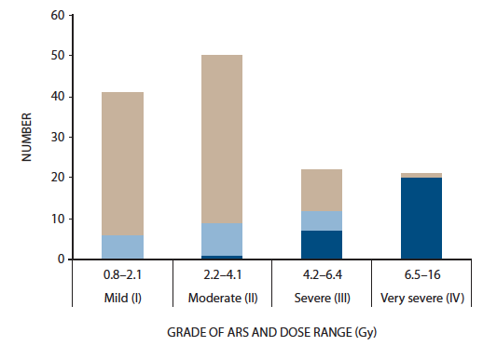
Effects on human health - ARS
134 cases of ARS, 28 fatalities.
19 further deaths up to 2006 – but none thought to be related to radiation.
Increased incidence of cataracts in those with highest doses
14 normal, healthy children born to ARS survivors within 5 years of the accident
www.unscear.org/docs/reports/2008/11-80076_Report_2008_Annex_D.pdf

Slide 23
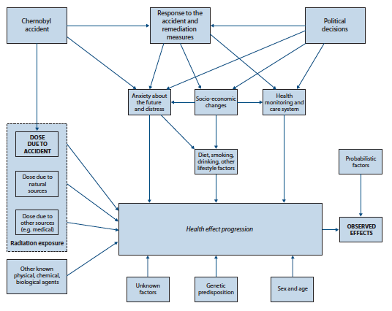
The needle in the haystack….
www.unscear.org/docs/reports/2008/11-80076_Report_2008_Annex_D.pdf

Slide 24
Health effects on the population
Only proven radiobiological effect on health of population has been increase in thyroid cancer in those exposed as children
Recent (2008) UNSCEAR report suggests that the most serious health effect of the accident was psychological – not physical

Slide 25
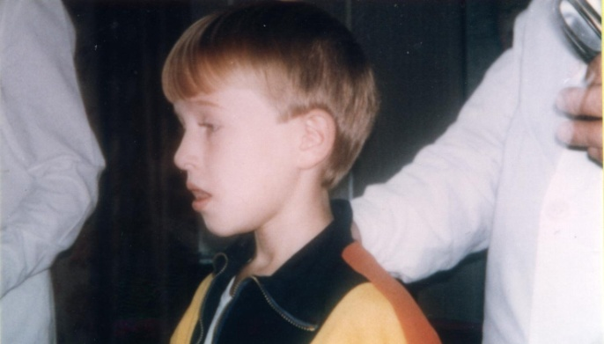
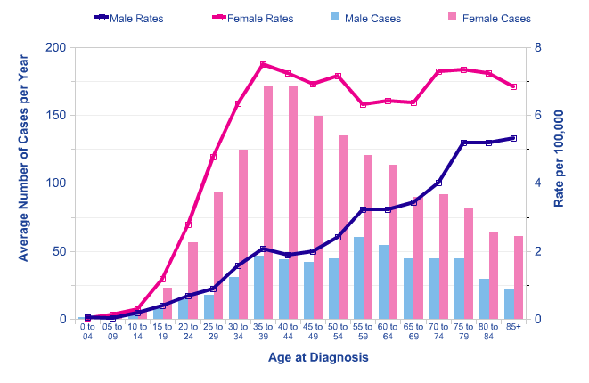
First reports of an increase in thyroid cancer in 1990, particularly in children.
Every cancer has a spontaneous incidence

Slide 26
Doses to the population
Evacuees – thyroid dose 500mGy
Not evacuated but resident in contaminated areas - thyroid doses 100mGy
Whole body doses to 6M residents = 9mSv
  80% of lifetime dose delivered by 2005
150,000 people living in most contaminated areas – 50mSv over 20 years (natural radiation average 1-2 mSv per year)

Slide 27
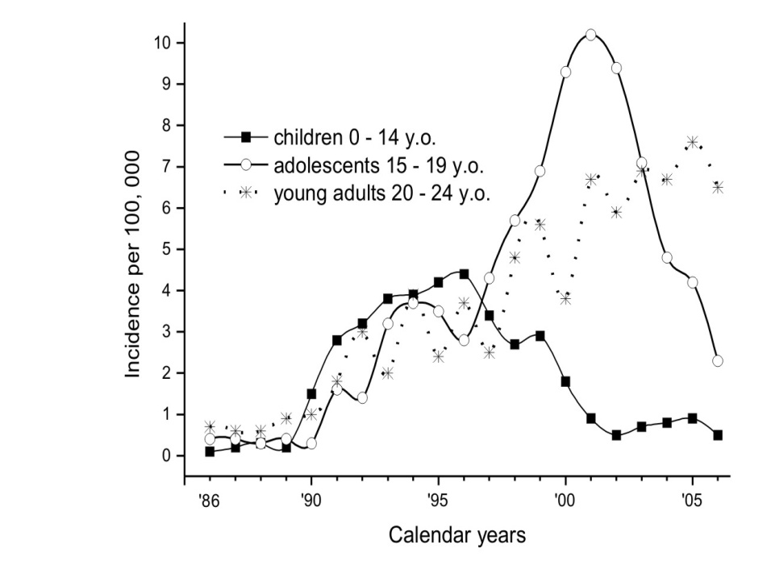
Cohort effect – carrying the risk with you

Slide 28
Why children?
Exposure
  Milk, dairy produce
  Small thyroid – larger dose to gland
Biology
  Thyroid still developing
  Increase in mutated clone size as a result of developmental growth

Slide 29
Treatment of thyroid cancer
Thyroid cancer treated by total thyroidectomy, radioiodine treatment for metastatic tumour deposits
Recurrence requiring further treatment c30%
Recurrence leading to death very rare – in England and Wales series with 20 year follow-up only 3%
Studies suggest this may be lower in post Chernobyl thyroid cancer (about 1%)
Tuttle et al., 2011 Clinical Oncology 23 (2011) 268-275

Slide 30
Chernobyl – 28 years on
  28 from ARS
  15 deaths from thyroid cancer in 25 years
  1% death rate overall predicted for thyroid cancer. Predicted total death rate thus far approx 60
  No (scientific) evidence of increased thyroid cancer outside 3 republics
  No effect on fertility, malformations or infant mortality
  No conclusion on adverse pregnancy outcomes or still births
  Heritable effects not seen and very unlikely at these doses

Slide 31
Chernobyl – 28 years on
Recent findings suggest:
  an increase of leukaemia risk among Chernobyl liquidators
  an increase in the incidence of pre-menopausal breast cancer in the most contaminated districts,
  possible low-dose effects on risk of cataracts and cardiovascular diseases.
  … need to be further investigated as lots of confounders

Slide 32
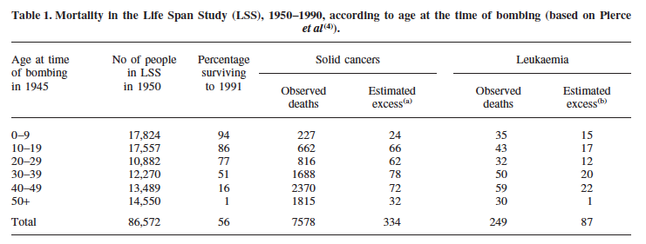
Is this surprising?
Muirhead (2003) Radiation Protect Dosim 104: 331-335
5% of all cancer deaths likely to be due to radiation – 95% due to other causes
Average loss of life expectancy for those who received non-zero doses is estimated to be 4 months. Cologne JB, Preston DL. Lancet 2000;356:303-7.

Slide 33
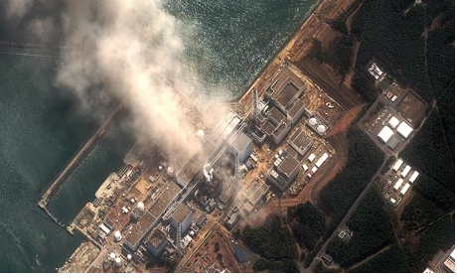
Fukushima

Slide 34


Chernobyl vs Fukushima
Move population away from source
Limit inhalation by staying inside and keeping windows and doors shut
Stop ingestion of contaminated foodstuffs
Block uptake of radionuclides (e.g. stable iodine prophylaxis)
☑
☑
☒
☑
☒
☑
☒
?

Slide 35
Radiation doses
On site
19,594 workers, 167 received doses of >100 mSv (6 >250mSv)
No ARS, no radiation related deaths
Population at large
150,000 people evacuated, sample of 1700 showed 98% <5mSv, only 10 >10mSv
Mean thyroid dose 4.2mSv in children (3.5 mSv adults) compared with 500mSv in Chernobyl evacuees

Slide 36
Fukushima Health effects
No radiation related deaths compared with 761 who died as a result of the evacuation, and 20,000 in tsunami
Unlikely to be any increase in thyroid cancer at the doses received
Psychological harm due to evacuation and radiophobia – very likely
Huge economic effect on local area and Japan as a whole

Slide 37
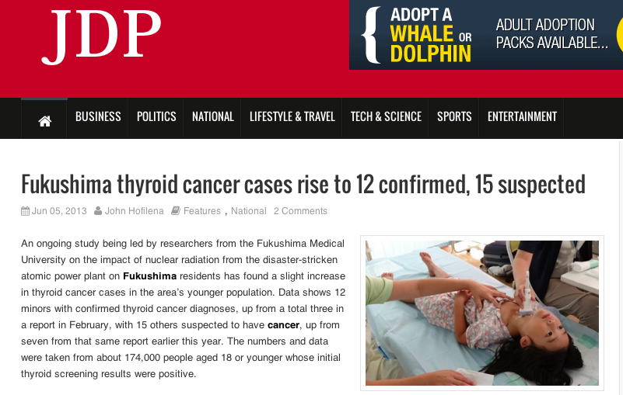
Fukushima health survey will produce large amounts of data that must be interpreted for the public – or it will be misinterpreted by the press and others
Radiation effect or screening artifact?

Slide 38
Thyroid doses (from radioiodine) less than 1/100th those of Chernobyl (4.2mSv vs 500 mSv)
Screening shifts natural incidence curve to the left
Frequency in Fukushima no higher than elsewhere in Japan
Frequency of screen detected cancer is always higher than statistics on cancer operations – do not confuse the two!
WHO and UNSCEAR reports state that there will be negligible health risks from Fukushima

Slide 39
What have we learnt?
Radiation exposure can increase cancer incidence in an exposed population.
Type of cancer depends on the type of radiation, dose and whether isotope is concentrated in particular tissue (by route of exposure or biology).
Young people more at risk than older people
Need to put risk from exposure to radiation into context with risk from other agents that cause cancer – risk communication

Slide 40
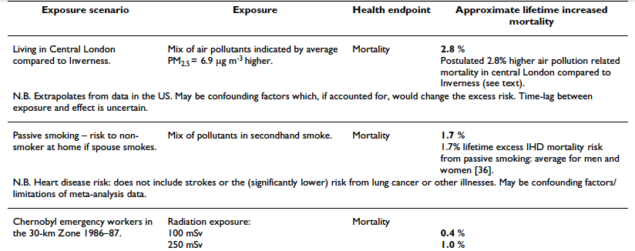
Smith BMC Pubic Health 2007 7:49

Slide 41
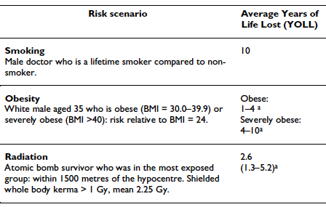
NB Radiation doses from nuclear accidents much lower than from A-bomb, so risk even lower

Slide 42
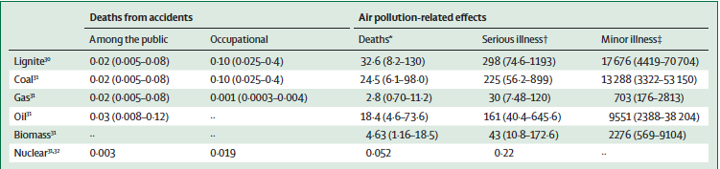
Health effects of energy production
Deaths and illness expressed as per TW (W¹²) for different sources of energy
Markandya and Wilkinson, Lancet (2007) 370: 979-90

Slide 43
Take home messages
Health consequences of a Nuclear Power plant accident may not be as bad as we first thought
We must separate fact from fiction to decide our future energy policy
Effects of climate change likely to kill more than nuclear accidents
Politics gets in the way of good science
Don’t believe everything you read on the internet or in the media

Slide 44
Further on-line info
Radiation doses in perspective
http://www.bbc.co.uk/news/magazine-15288975
http://xkcd.com/radiation/
Chernobyl
www.chernobyltissuebank.com
http://www.chernobyltissuebank.com/clinical_oncology.html
Fukushima
http://www.world-nuclear-news.org/taghub.aspx?tagid=Fukushima

